Slide 1
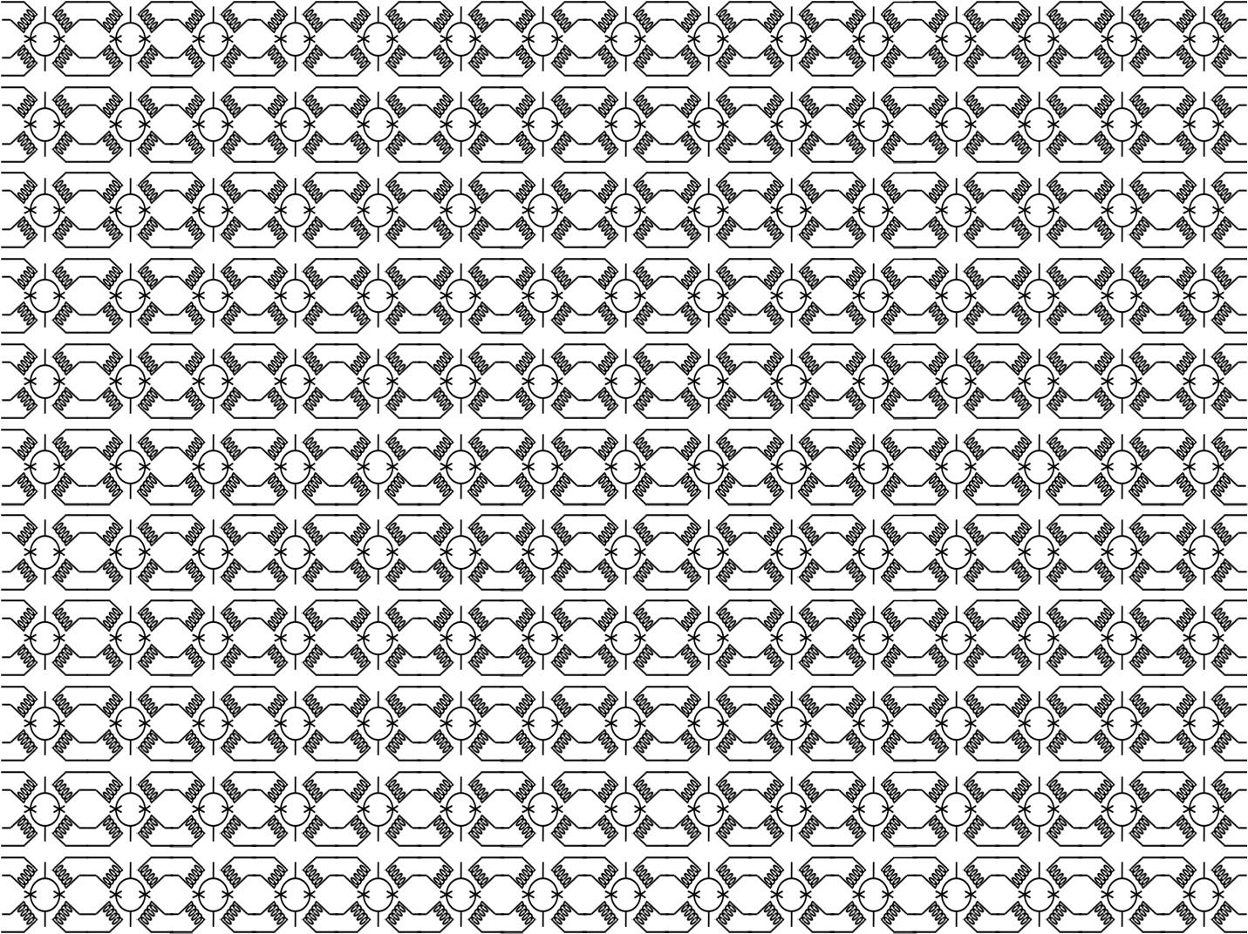
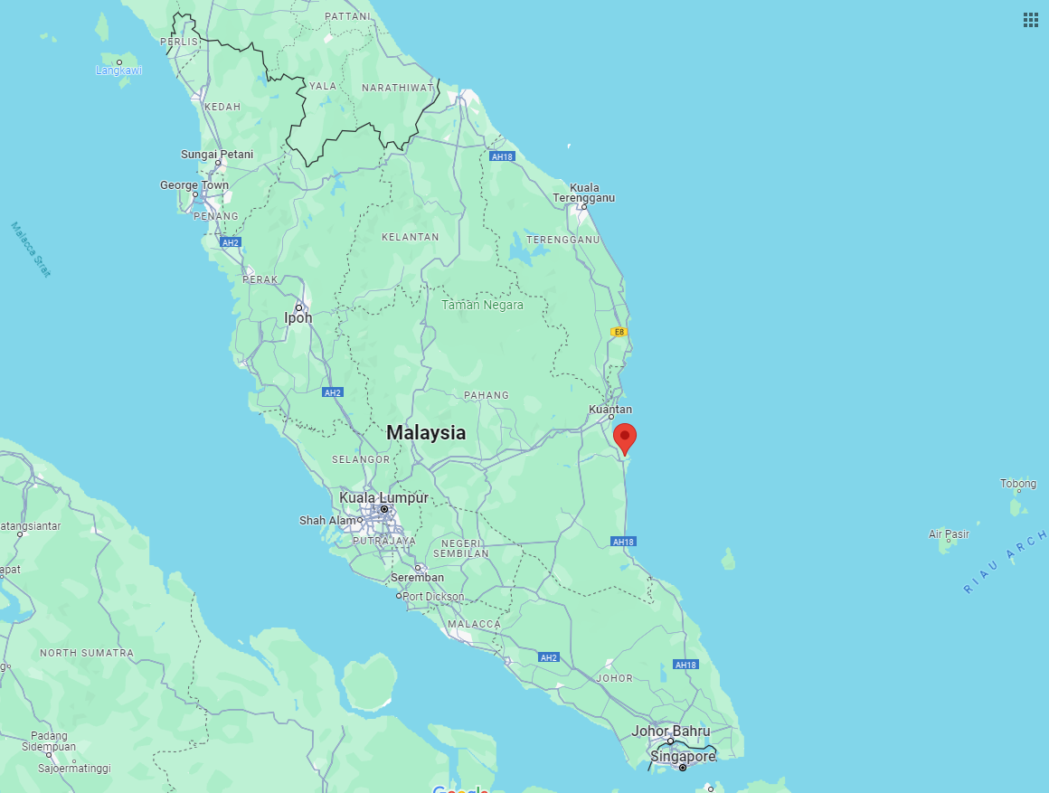
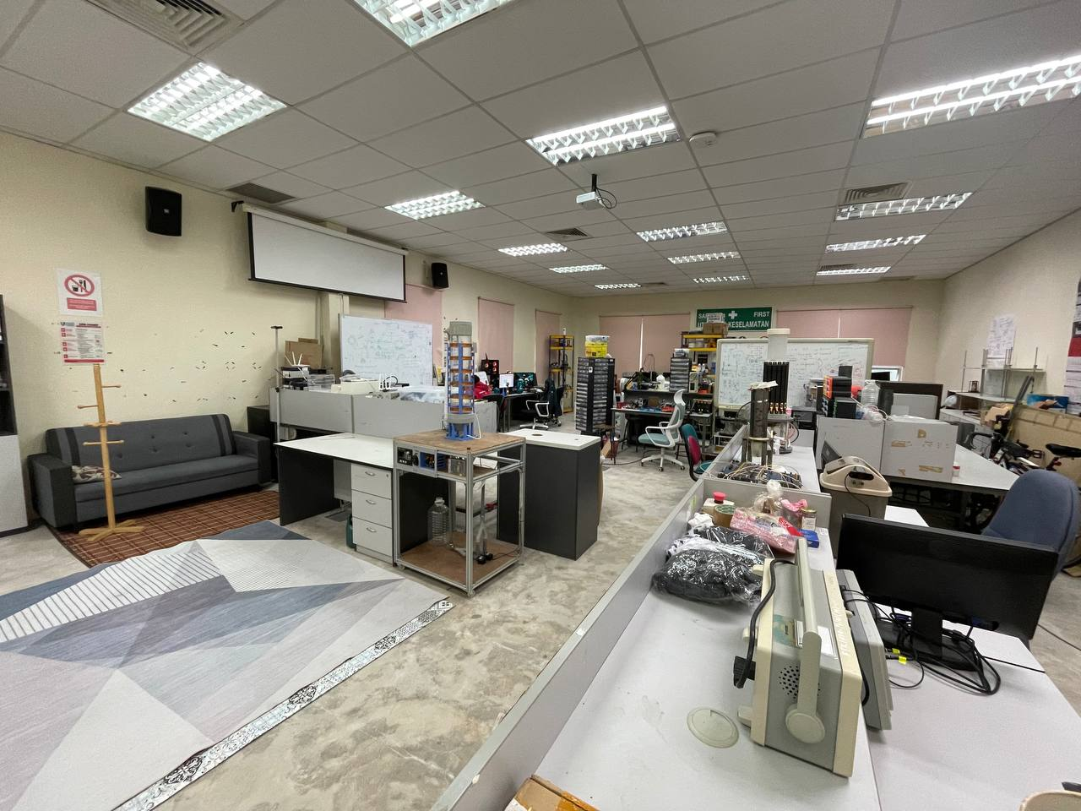
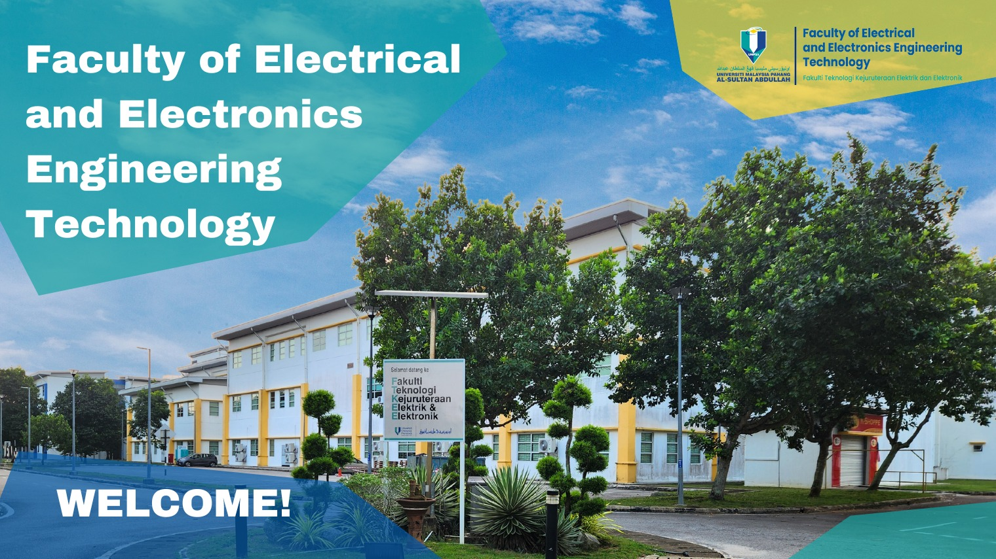
Advanced Metrology & Sensing (AMES) Group
Founded in 2019
Located in Faculty of Electrical and Electronics Engineering (FTKEE), Universiti Malaysia Pahang Al-Sultan Abdullah (UMPSA), Pekan Campus

Slide 2

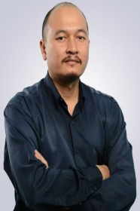
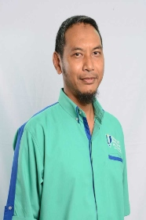
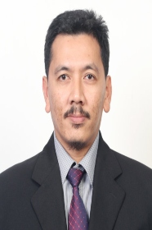
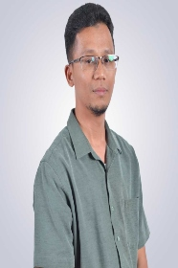
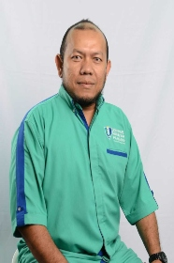
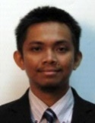
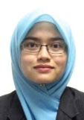
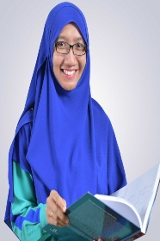
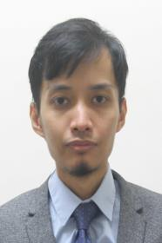
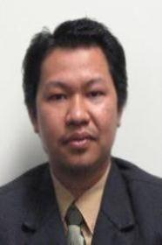
Advanced Metrology & Sensing (AMES) Group
MEMBERS
M. Mawardi
M. Sharfi
Mohd Razali
Hadi
Saari
Najib
Daud
Manap
(Assoc. Prof., Ph.D.)
(Assoc. Prof., Ph.D.)
(Assoc. Prof., Ph.D.)
(Assoc. Prof., Ph.D.)
M. Anwar
A. Johari
Amir
Izzani
Yasmin
Zawawi
Mohamad
Mohamed
Abdul Wahab
Assoc. Prof., Ph.D.
(Snr. Lecturer, Ph.D.)
(Snr. Lecturer, Ph.D.)
(Snr. Lecturer, Ph.D.)
Nurhafizah
Syukran H.
Razali
Abu Talip
Norazman
Muda
(Snr. Lecturer, Ph.D.)
(Snr. Lecturer, Ph.D.)
(Snr. Lecturer, Ph.D.)

Slide 3
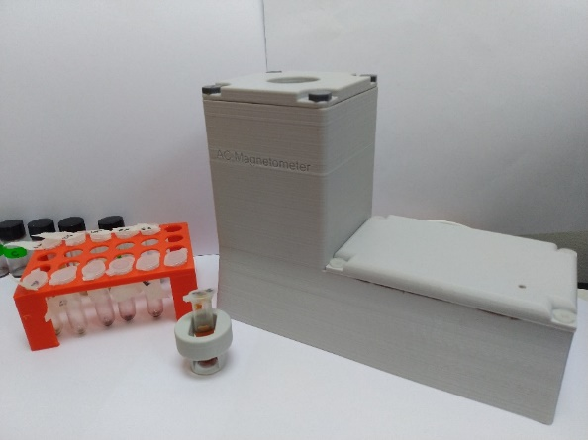
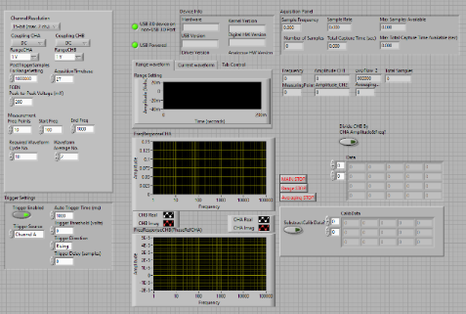
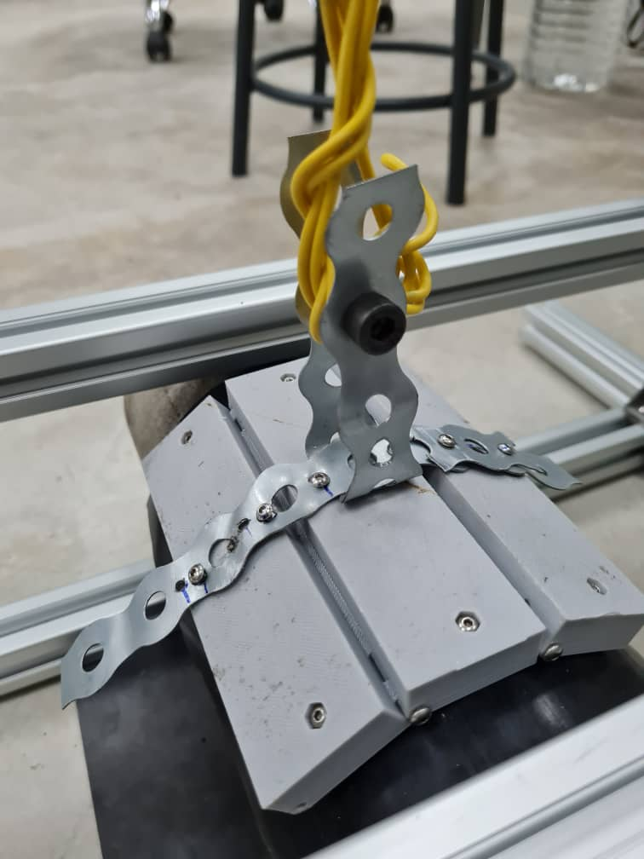
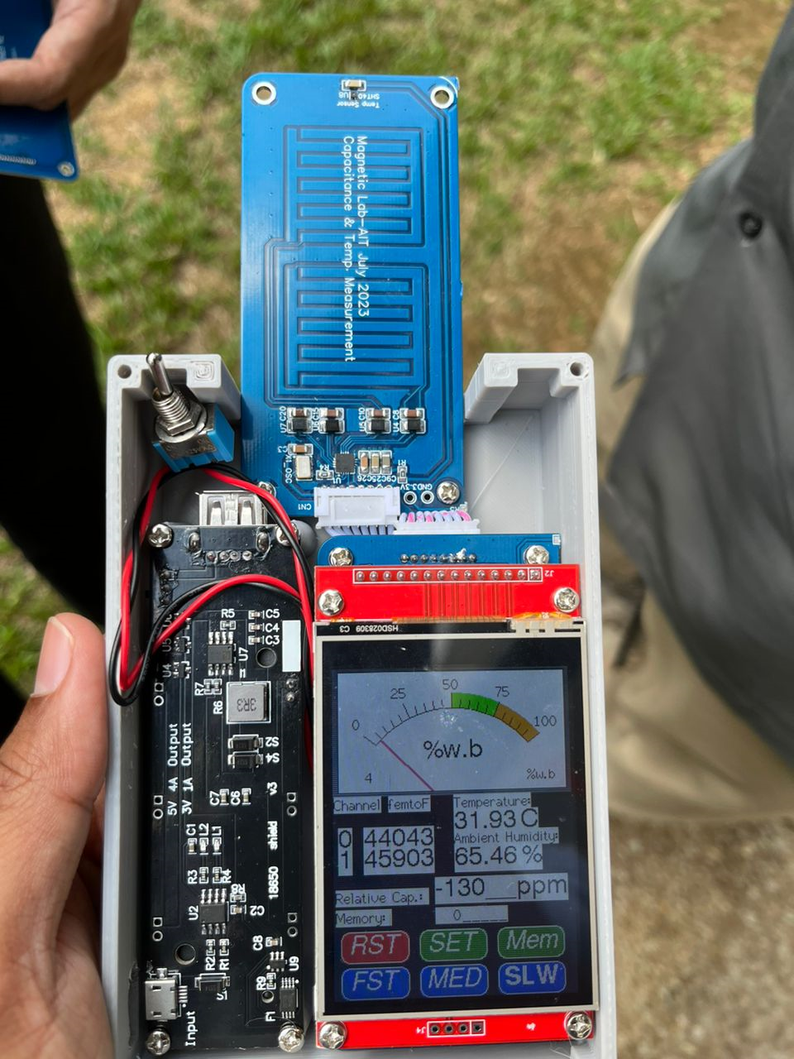
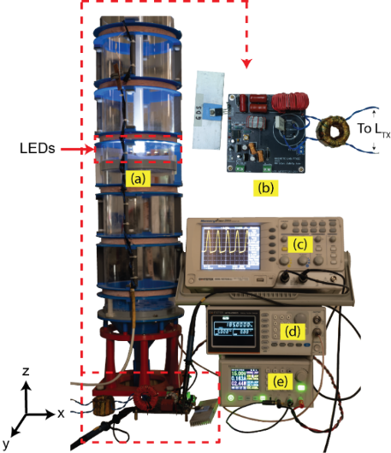
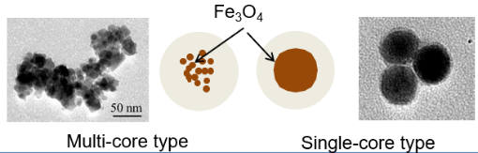
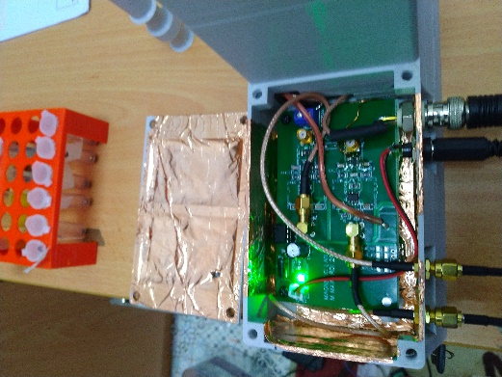
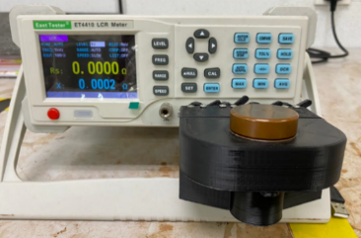
Topic: Magnetic Device & Measurement
Mohd Mawardi Saari (Ph.D)
FTKEE & Centre for Advanced Industrial Technology
mmawardi@ump.edu.my
Research Contents:
Magnetic Evaluation Device for Magnetic Nanoparticles
Non-Destructive Test using Electromagnetic Method
Applications related to magnetic instrumentations

Slide 4
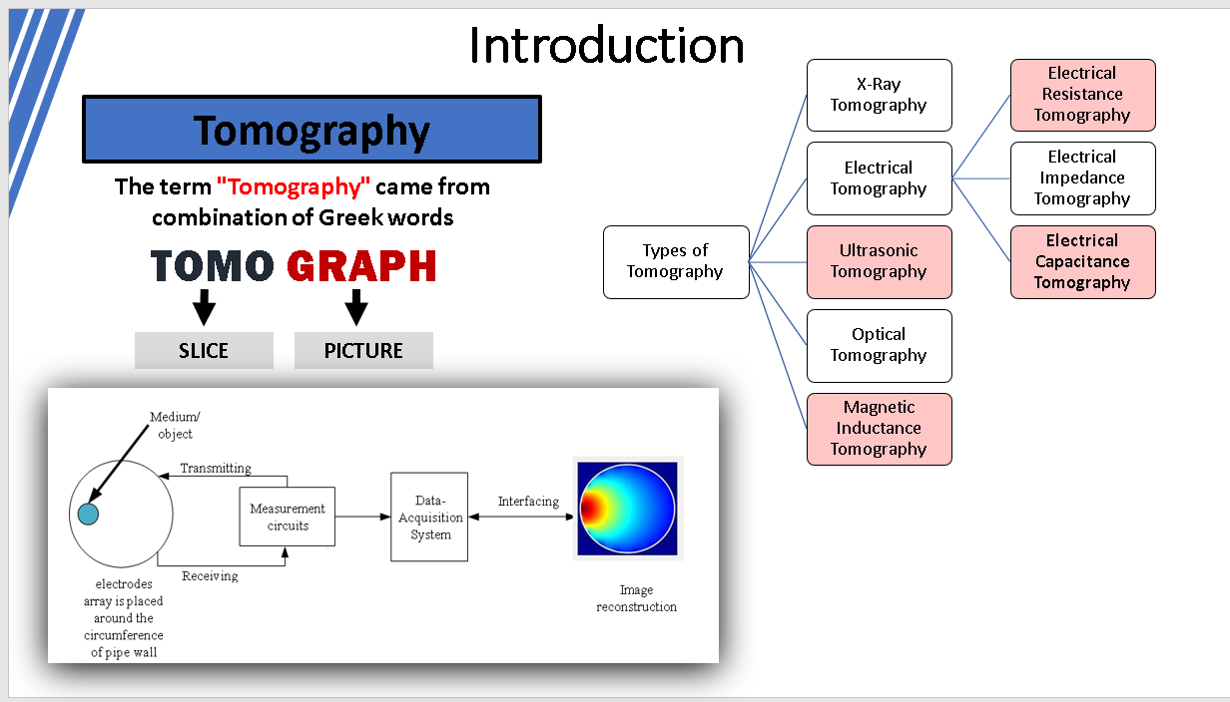
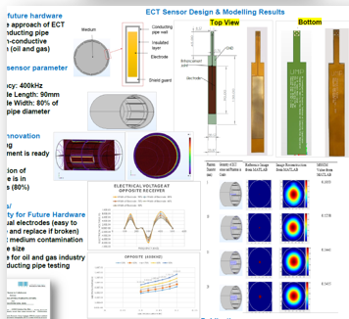
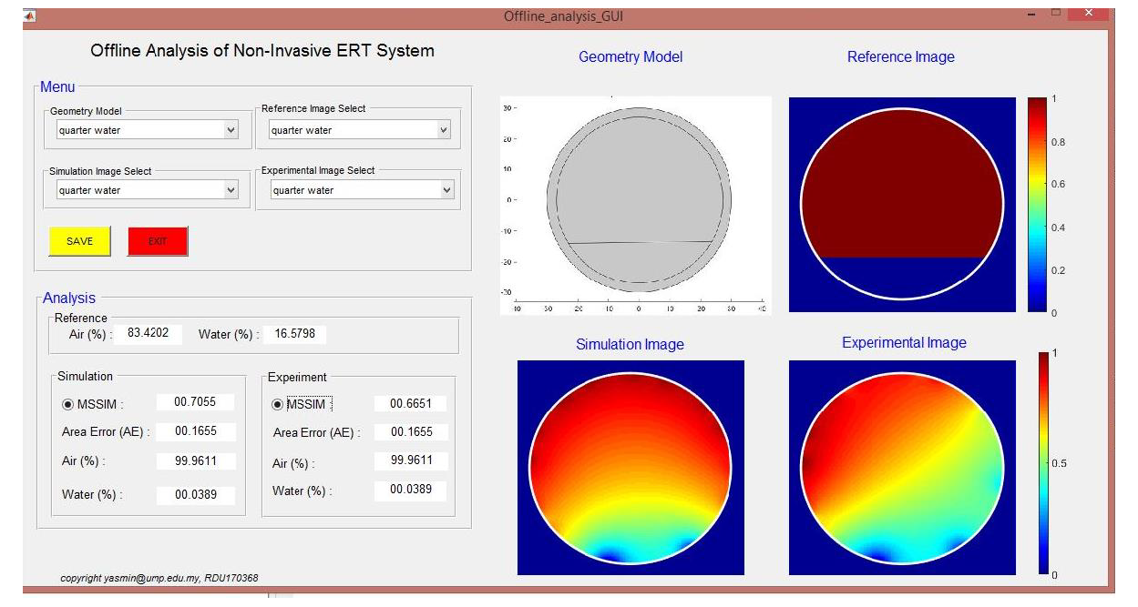
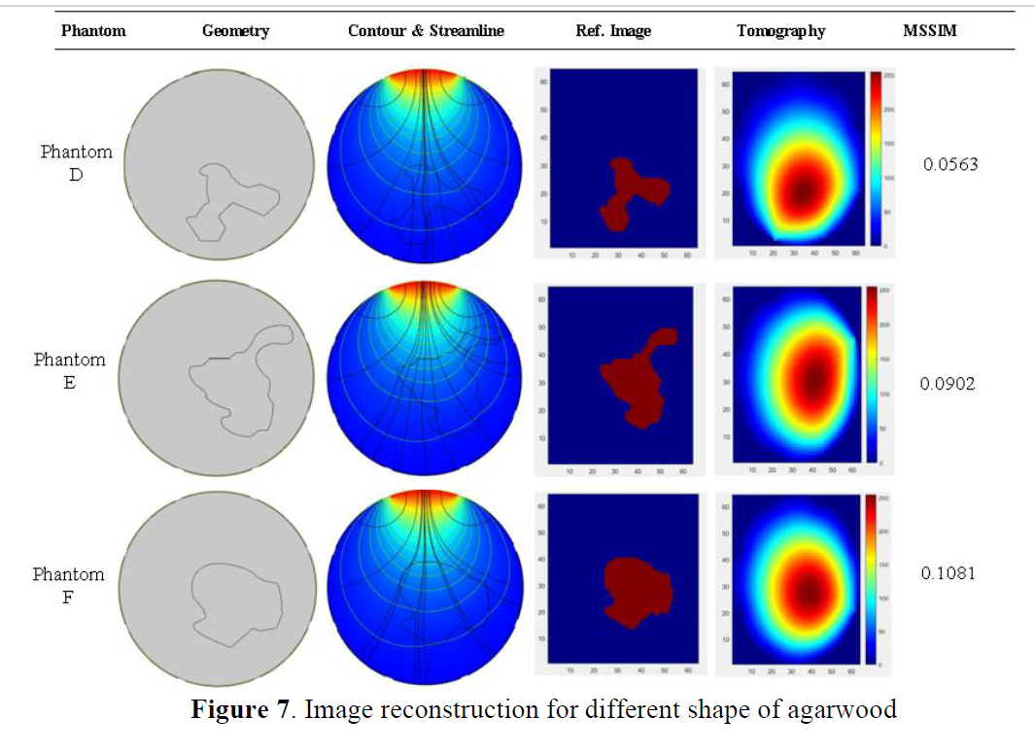
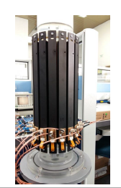
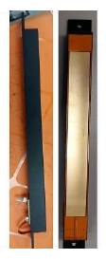
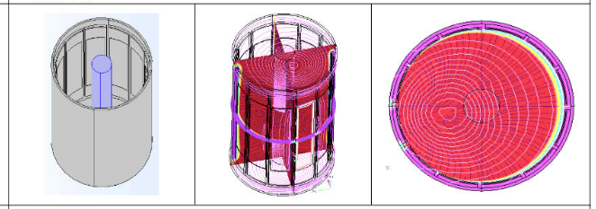
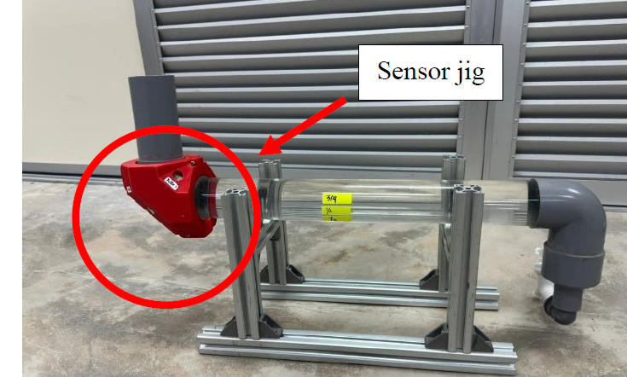
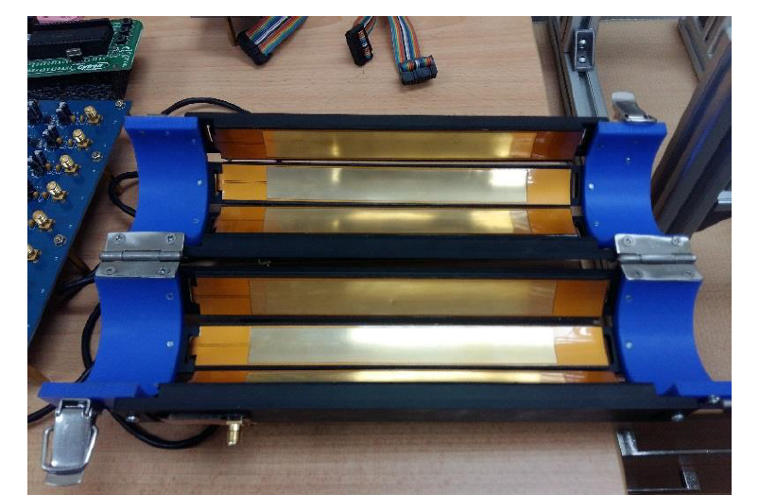
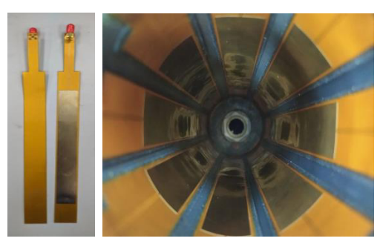
Topic: Process Tomography, Sensor Technology and Its Application
Ts Dr Yasmin Abdul Wahab
FTKEE & Centre for Advanced Industrial Technology
yasmin@umpsa.edu.my
Research Contents:
Modelling and Simulation of Process Tomography
Sensor Design and Development of Process Tomography
Sensor Technology and Its Application

Slide 5
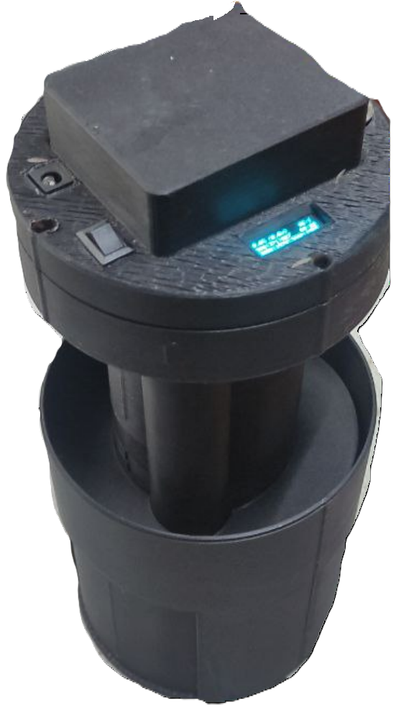
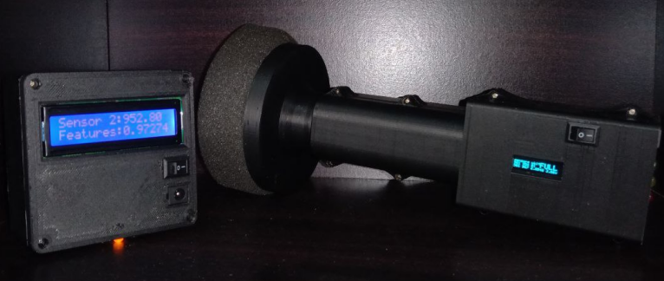
Topic: Odor & NIR-Optical Sensing
Muhammad Sharfi bin Najib (Ph.D)
FTKEE & Centre for Advanced Industrial Technology
sharfi@umpsa.edu.my
Research Contents:
Odor detection system
NIR-Optical Sensing
Unified Odor and NIR-Optical Sensing
E-ANFUN
E-BSR
O-BSR

